Slide 1

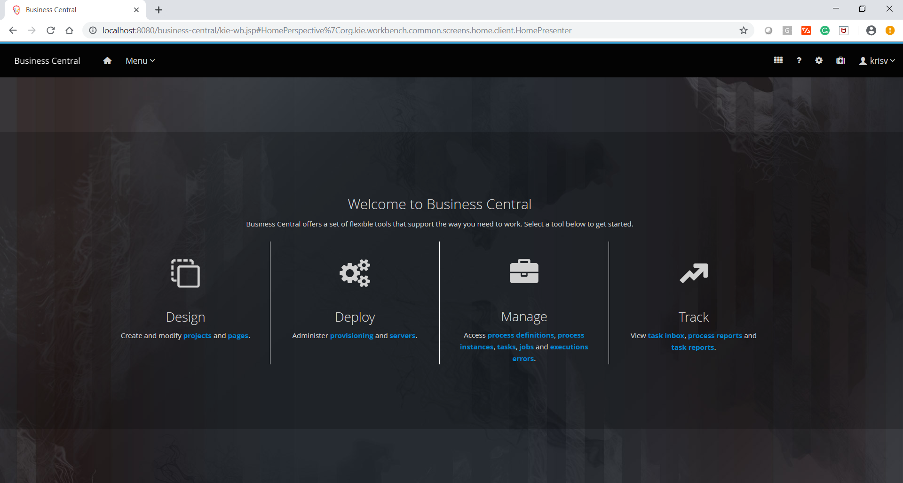
Console
Notes:
Working with the jBPM console

Slide 2
Agenda
01
02
Running the process management console
03
Adding new process / task forms
Installation
04
05
06
REST Interface
Quiz
Conclusion

Slide 3
Installation

Slide 4
Running the process management console

Slide 5
Adding new process / task forms

Slide 6
REST Interface

Slide 7

Quiz
Console

Slide 8
Quiz
Below is the .war file which install the jBPM Console
Central.war
jbpm-console.war
business-central.war
Business-center.war

Slide 9

Answers
Below is the .war file which install the jBPM Console
Central.war
jbpm-console.war
business-central.war
Business-center.war

Slide 10
Quiz
REST Interface used for loosely couple interface
True
False

Slide 11
Answers
REST Interface used for loosely couple interface
True
False

Slide 12
Conclusion

Slide 13


Summary
In this session, you have learnt:
Installation
Running the process management console
Adding new process / task forms
REST Interface

Slide 14

India : +91-7847955955
US : 1-800-216-8930 (TOLL FREE)
support@intellipaat.com
24X7 Chat with our Course Advisor
Notes:
Thank you!

